Slide 1
Eye-based wheelchair control and task manager for disable person
Notes:
Hello everyone, Assalamualaikum.

Slide 2
FROM: Team KUET_CV
Rahat-uz-Zaman (2k15)
Sakib Reza (2k15)
Hasib Iqbal Pranto (2k14)
Asifur Rahman (2k15)
Department of Computer Science and Engineering (CSE)
Khulna University of Engineering and Technology
Notes:
I am Rahat Zaman of KUET.CV from Khulna University of Engineering and Technology, Bangladesh.

Slide 3
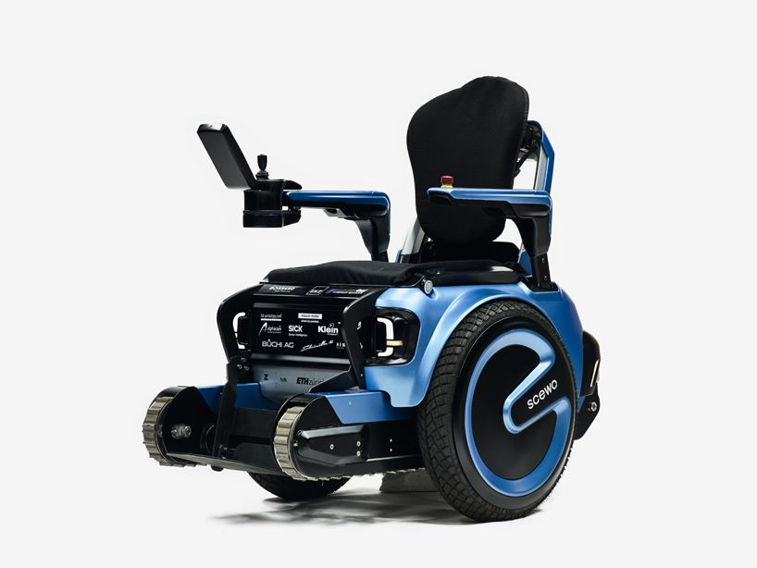
Overview
In our society, there are people who have critical physical disability. Some of them
have paralysis
cannot move any body part
except only eyes and/or head.
Our system will make them able to operate wheel chair and task manager using their eyes, voice and/or head gesture.
Notes:
Did you know that just of 1 in 4 of today's 20 year-olds will become disabled before they reture? And also this fact that estimated population of people with disabilities are 650 million where about 38% of them are unable to move[SourceAmarica's statistics].
That is why we came up with an innovative idea that is never been thought before and has a high probability to change the world for disabled persons.

Slide 4
Eye-based wheelchair control and task manager for disable person
Notes:
We have designed a system where those person can do almost all daily works with only their active parts like eye, voice and head. The name of our project is Eye-based wheelchair control and task manager for disable person.

Slide 5
Aim and Objectives
Overcoming any type of physical disability using eyes, voice and/or head gesture
Operating task manager and wheel chair using eye gaze/eye blink/head gesture/ voice command
Make disabled persons able to do everyday works
Notes:
With our project, we want to overcome physical disabilities with only eye, head etc. So we added as much functionality as possible which can be done only with eye.

Slide 6
Who can use this with which features
Person’s active body part |  |  |  |  | Feature
Hand | Leg | Eye | Head | Speak | Voice | Eye-gaze | Eye-blink | Head-guesture
❌ | ❌ | ✔ | ❌ | ❌ | ❌ | ✔ | ✔ | ❌
❌ | ❌ | ✔ | ❌ | ✔ | ✔ | ✔ | ✔ | ❌
❌ | ❌ | ✔ | ✔ | ❌ | ❌ | ✔ | ✔ | ✔
❌ | ❌ | ✔ | ✔ | ✔ | ✔ | ✔ | ✔ | ✔
❌ | ❌ | ❌ | ❌ | ✔ | ✔ | ❌ | ❌ | ❌
Notes:
This is the chart by which we can see that who are our targets and we can see that almost all severely disabled persons can use our software with ease. So what can we do with the software? The answer is everything.

Slide 7
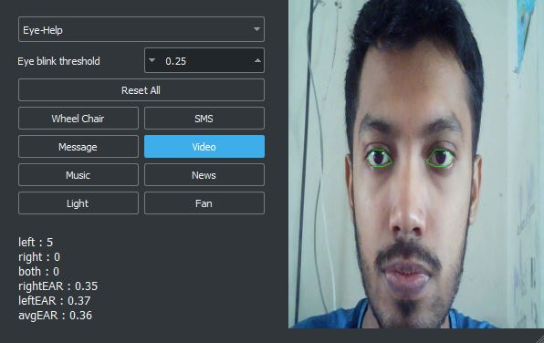
Task manager to control both menu and wheel chair
The person can do the following things with this task manager.
Control wheel chair
SMS
Email
Video
Music
News
Turn on/off light
Turn on/off fan
Place your screenshot here
Control tasks by
Eye
Head
Voice
Notes:
We have a task manager by which, the user can control and do things with their active parts.

Slide 8
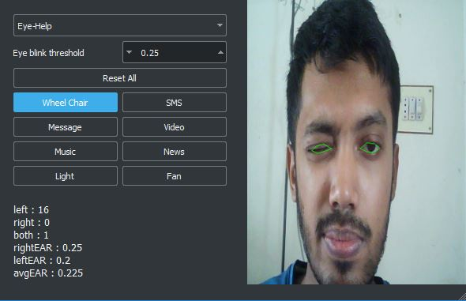
Controlling menu with eye blinks
One can use only blinks to navigate through the whole task manager.
Place your screenshot here
Blink right
Blink left
Blink both
Move selection right
Move selection left
Press selected menu

Slide 9
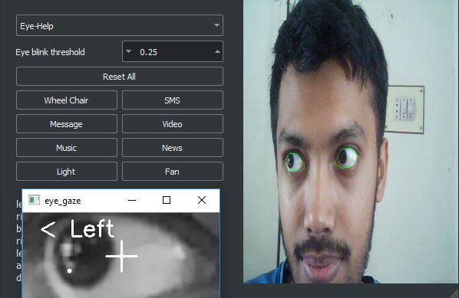
Controlling wheel chair with eye gaze
One can go 3 directions with eye gaze and start/stop with eye blinks.
Place your screenshot here
Look right
Look left
Look front
Move wheel chair right
Move wheel chair left
Move straight
Blink
Start/Stop

Slide 10
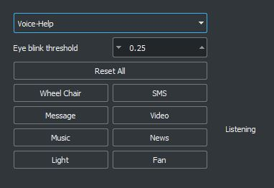
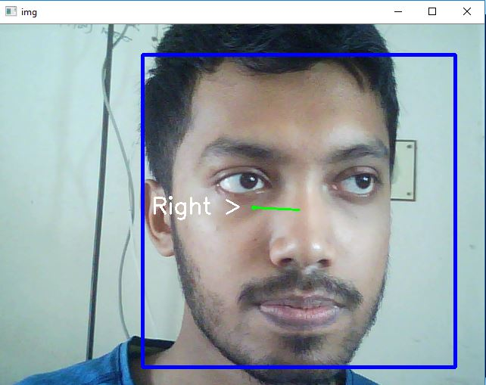
Controlling wheel chair with head gesture
Go 3 directions with head gesture and start/stop with eye blinks.
Place your screenshot here
Move right
Move left
Move up
Move wheel chair right
Move wheel chair left
Move straight
Move down
Stop

Slide 11
Controlling wheel chair and task manager with voice command
Tell the task manager what to do.
Place your screenshot here
“Right”
“Left”
“Start”
Move wheel chair right
Move wheel chair left
Move straight
“Stop”
Stop

Slide 12
Our Future Plan
Increasing the accuracy of eye gaze, eye blink, head gesture and voice command
Adding more real life features
Making this system more robust, accurate and deployable for general users

Slide 13
Thank You!
Any questions?

